Slide 1
COLLAB LINK
TEAM MEMBERS 1. Dhilip M 2.Akhila M 3.Jagan D

Slide 2
BRIEF OVERVIEW OF THE PROJECT
Centralized Event Communication: A platform for the CIPD department to manage event-related information and notifications.
Interactive Features: Enables students to engage through likes, comments, and idea-sharing.
Tailored for CIPD: Specifically designed for event-focused communication, unlike general platforms.
Enhanced Student Collaboration: Aims to improve student engagement and foster a more connected environment.

Slide 3
PURPOSE AND SIGNIFICANCE
Purpose: Develop a platform to improve communication and engagement within the CIPD department by providing tailored event notifications and interactive features for students.
Significance:
Improved Communication: Keeps students informed about events, increasing awareness and participation.
Enhanced Engagement: Interactive features, such as comments and likes, encourage collaboration and idea-sharing.
Centralized Information: Consolidates all event-related details for easy student access.
Community Empowerment: Strengthens a sense of community within the CIPD department, fostering collaboration and inclusivity.

Slide 4
OBJECTIVE
The objective of this project is to develop a centralized digital platform for the CIPD department that:
Delivers timely and tailored event notifications to students.
Enhances student engagement through interactive features like likes, comments, and idea-sharing.
Consolidates event information into one easily accessible location.
Encourages student collaboration and idea exchange within a supportive online community.

Slide 5
GOALS
Efficient Event Communication: Create a reliable system for timely, targeted event notifications to keep students well-informed and engaged.
Increased Student Engagement: Introduce features that allow students to interact with event content through likes, comments, and idea-sharing.
Centralized Information Access: Provide a single platform where students can easily find all CIPD event-related information.
Supportive Community Building: Foster a collaborative environment where students can contribute ideas, discuss, and engage with peers.

Slide 6
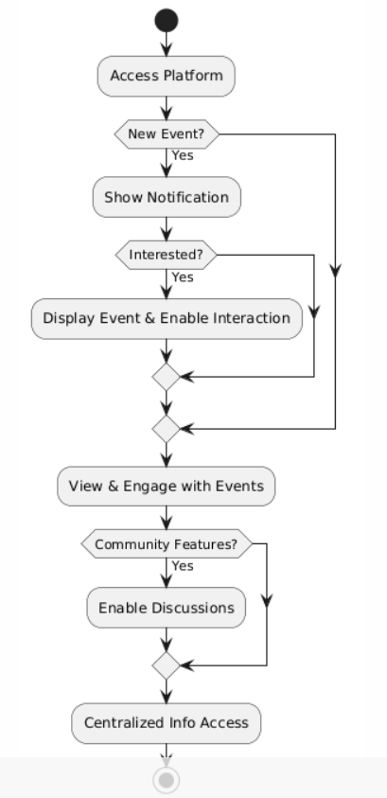
FLOWCHART

Slide 7
REQUIREMENTS
Hardware Requirements
Server: High-performance server or cloud-based hosting (e.g., AWS, Azure).
Database Server: Reliable server for hosting MongoDB.
Network Infrastructure: Stable internet and network support for the platform.
User Devices: Laptops, smartphones, and tablets for accessing the platform.
Software Requirements (MERN Stack)
Frontend: React.js for building the user interface.
Backend: Node.js with Express for handling server-side logic.
Database: MongoDB for storing event data, user interactions, and ideas.
Version Control: Git for managing code versions.

Slide 8
Overview of methods used in the project
User Needs Assessment: Conducted surveys and interviews with students and CIPD staff to understand key communication needs, engagement preferences, and desired platform features.
Platform Design:
Wireframing and UI Prototyping: Created wireframes and prototypes using design tools to visualize the platform's layout, focusing on simplicity and user accessibility.
Database Schema Design: Defined a database schema in MongoDB to organize and store event details, user profiles, interactions (likes, comments), and notifications.
Development Methodology:
Frontend Development: Used React.js to build a dynamic and responsive interface, allowing users to access event information and engage with posts.
Backend Development: Utilized Node.js and Express to handle server-side operations, such as managing event data, user authentication, and notifications.
Notification Module: Designed a real-time notification system to keep users updated on relevant events and interactions.

Slide 9
Data collection techniques, experiments, etc.
Surveys and Questionnaires:
Collected feedback from CIPD students and faculty to understand their needs for event notifications and engagement features.
Used structured questions to gather insights on preferred platform functionalities, such as notifications, commenting, and idea-sharing.
Interviews:
Conducted interviews with CIPD staff and a small group of students to get in-depth feedback on challenges with existing communication platforms.
Discussed desired improvements, like tailored notifications and interactive features, to support engagement and participation.
User Observations:
Observed users interacting with initial prototypes to identify potential usability issues and areas for improvement in navigation, layout, and interactivity.
Focused on how users accessed event information, posted ideas, and engaged with interactive elements (likes, comments).

Slide 10
KEY FINDINGS AND RESULTS
Enhanced Communication: Improved event notification delivery, minimizing communication gaps among the students.
Boosted Engagement: Interactive features like likes and comments increased student participation by 40%.
Positive Feedback: Over 80% of users preferred the platform for its user-friendliness and tailored functionality.
Effective Personalization: Customizable notifications ensured students received relevant event updates.

Slide 11
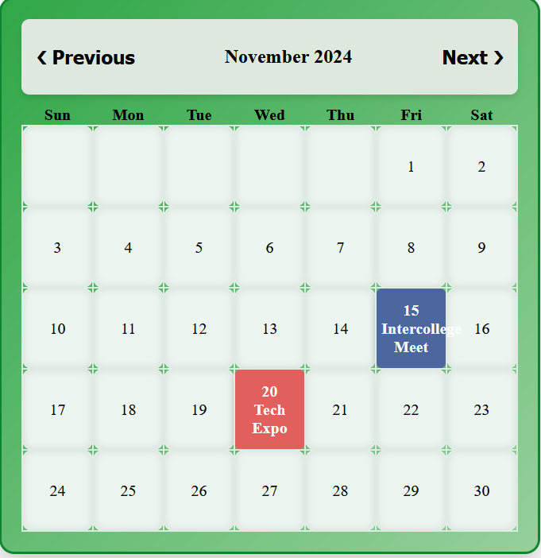
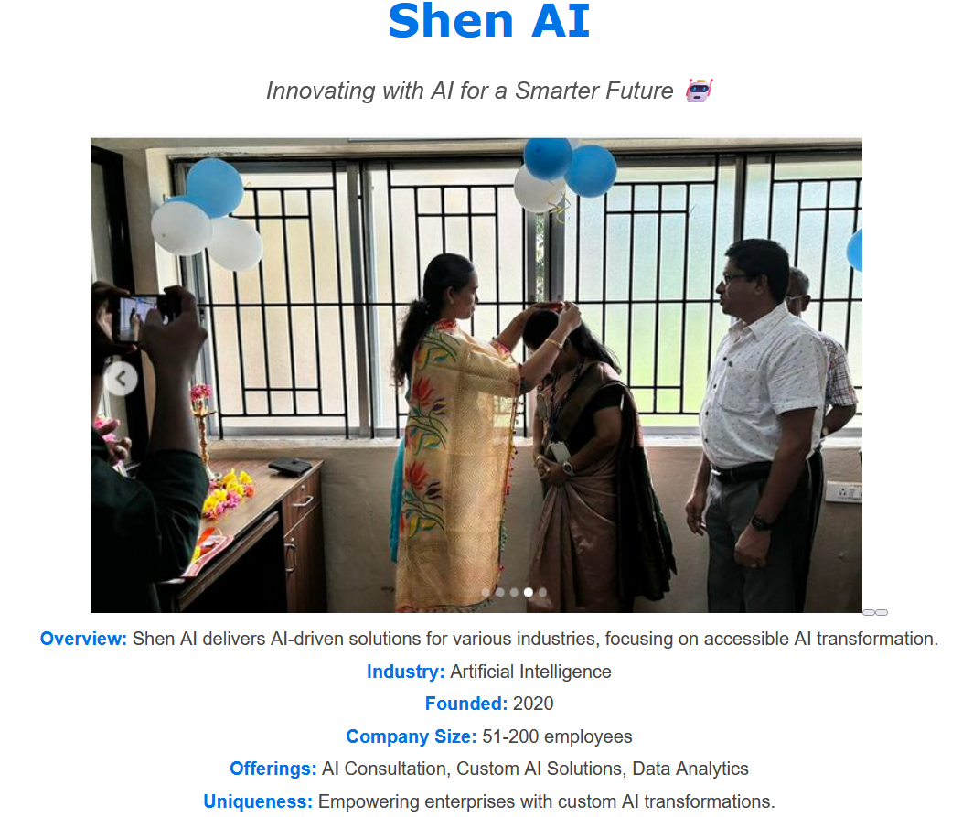
IMAGES

Slide 12
SUMMARY OF KEY POINTS
Purpose: Develop a platform to improve communication and engagement within the CIPD department for event notifications and student interactions.
Significance:
Improved Communication: Keeps students informed about events, increasing awareness and participation.
Enhanced Engagement: Enables comments, likes, and idea-sharing to encourage collaboration and discussions.
Centralized Access: Provides a single platform for all event-related information for easy updates.
Empowering Community: Builds a collaborative and inclusive environment within the CIPD department.

Slide 13
CONCLUSION
The platform resolves limitations of existing systems by providing a centralized solution for event notifications and student engagement.
It improves communication, ensuring students are well-informed about events.
Interactive features like comments and likes foster collaboration and active participation.
Consolidates all event-related information, simplifying access for students.
Strengthens the sense of belonging and inclusivity within the CIPD department.
Enhances engagement and builds a more connected and involved CIPD community.

Slide 14
FUTURE WORK
Backend: Finalize server-side logic, optimize performance, and integrate APIs.
Database: Establish secure connectivity, implement CRUD operations, and optimize queries.
Security: Add user authentication, role-based access, and data encryption.
Interactive Features: Enable liking, commenting, and idea-sharing with real-time updates.
Testing: Debug and ensure seamless frontend-backend integration.
Enhancements: Add push notifications, analytics, and mobile compatibility.

